Slide 1
Polymorphism
A deep dive into one of the core concept of object-oriented programming.

Slide 2
Contents we aim to present
What is Polymorphism?
How is polymorphism achieved?
Dynamic and Static polymorphism .
Method/Function Overloading.
Method/Function Overriding.
Different classification of Polymorphism?
Ad-Hoc
Inclusion
Parametric
Coercion
Advantages and Disadvantages of Polymorphism.
Polymorphism vs. Inheritance.
Summary.

Slide 3
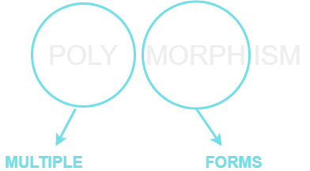
What is Polymorphism?
Poly (Multiple), morph (form).

Slide 4
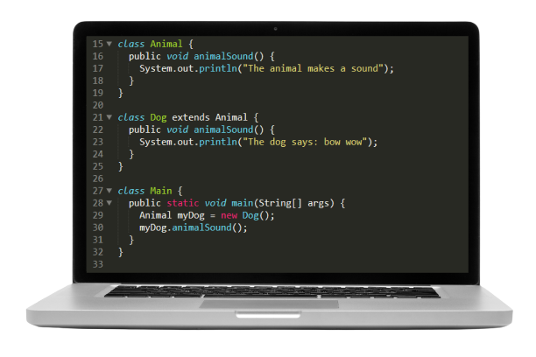
Polymorphism
Polymorphism is the ability of an object to take on many forms. The most common use of polymorphism in OOP occurs when a parent class reference is used to refer to a child class object.

Slide 5





In a family as a guardian.
Real life example of Polymorphism
In a sitting as a friend.
In an office as an employee
A Person
In a sports team as a player.

Slide 6
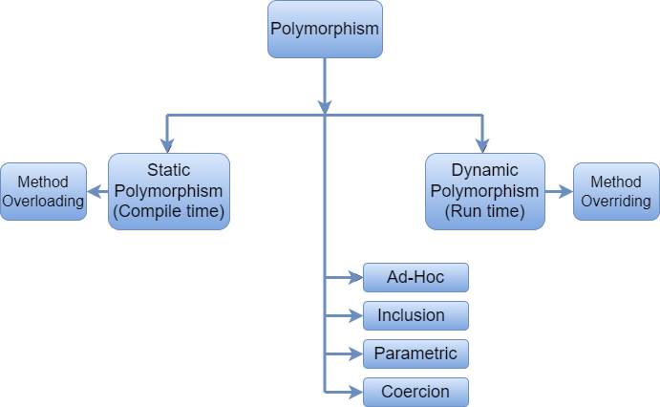
Classification of Polymorphism

Slide 7
Static Polymorphism (Compile time polymorphism)
Static Polymorphism is the linking of a function with an object during compile time is called static. It is also called static binding. This type of polymorphism is achieved by method/function overloading or operator overloading.
Method/Function Overloading: When there are multiple functions/methods with same name but different parameters then these functions are said to be overloaded. Functions/methods can be overloaded by change in number of arguments or/and change in type of arguments or change in sequence of arguments.

Slide 8
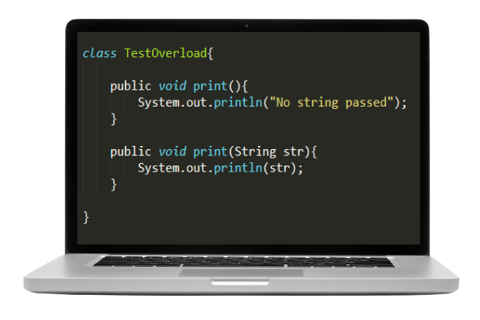
Static Polymorphism

Slide 9
Dynamic Polymorphism
Dynamic polymorphism is a process or mechanism in which a call to an overridden method/function is to resolve at runtime rather than compile-time. It is also known as runtime polymorphism or dynamic method dispatch. We can achieve dynamic polymorphism by using the method/function overriding.
Properties of Dynamic Polymorphism:
It decides which method is to execute at runtime.
It can be achieved through dynamic binding.
It is required where a subclass object is assigned to a super-class object for dynamic polymorphism.
Inheritance involved in dynamic polymorphism.

Slide 10
Dynamic Polymorphism
Method/Function Overriding: If a subclass provides the specific implementation of the method that has been declared by one of its parent class, it is known as method overriding.
Method overriding is used to provide the specific implementation of a method which is already provided by its superclass.
Method overriding is used for runtime polymorphism.

Slide 11
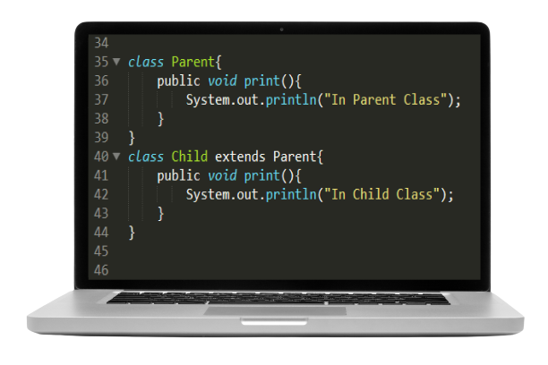
Dynamic Polymorphism

Slide 12
Other classifications
Ad-Hoc: The Ad-Hoc polymorphism is called as overloading. This allows function with same name to act in different manner for different types. The function and the operator both can be overloaded. Some language does not support operator overloading, but function overloading is common. This is similar to method overloading in static polymorphism.

Slide 13
Other classifications
Inclusion: The Inclusion polymorphism is called as subtyping. This allows to point derived classes using base class pointers and references. This is runtime polymorphism. We do not know type of the actual object until it is executing. We need virtual function in C++ to achieve this inclusion polymorphism

Slide 14
Other classifications
Coercion: The Coercion polymorphism is called as casting. This type of polymorphism occurs when an object or the primitive is cast into some other type.

Slide 15
Other classifications
Parametric: The Parametric polymorphism is called as Early Binding. This type of polymorphism allows to use same piece of code for different types.

Slide 16
Advantages and Disadvantages of Polymorphism
Advantages of Polymorphism:
It helps programmers reuse the code and classes once written, tested and implemented. They can be reused in many ways.
Single variable name can be used to store variables of multiple data types(Float, double, Long, Int etc).
Polymorphism helps in reducing the coupling between different functionalities.

Slide 17
Advantages and Disadvantages of Polymorphism
Disadvantages of Polymorphism:
One of the disadvantages of polymorphism is that developers find it difficult to implement polymorphism in codes.
Run time polymorphism can lead to the performance issue as machine needs to decide which method or variable to invoke so it basically degrades the performances as decisions are taken at run time.
Polymorphism reduces the readability of the program. One needs to identify the runtime behavior of the program to identify actual execution time.

Slide 18
Polymorphism vs. Inheritance.
Inheritance is creating a new class using the properties of the already existing class. Where polymorphism is basically a common interface for multiple form.
Inheritance is basically implemented on classes. Polymorphism is basically implemented on function/methods.

Slide 19
Polymorphism vs. Inheritance.
Inheritance is used to support the concept of reusability in OOP and reduces the length of code. Whereas polymorphism allows object to decide which form of the function to be invoked when, at compile time(overloading) as well as run time(overriding).

Slide 20
Polymorphism vs. Inheritance.
Inheritance may be a single inheritance, multiple inheritance, multilevel inheritance, hierarchical inheritance and hybrid inheritance. Polymorphism may be a compile time polymorphism (overloading) or run-time polymorphism (overriding).

Slide 21
Summary
Polymorphism is one of the most important concepts of object-oriented programming.
Acts differently under different contexts.
Method overloading increases the readability of program.
Method overriding is used to achieve run-time polymorphism.
The idea behind bringing the concept of polymorphism is flexibility. Further the ability to process a large number of objects in a single reference variable, makes the coding a bit easier. Therefore, the concept should be used in the daily coding tasks and embrace its effectiveness.

Slide 22

If polymorphism had a face

Slide 23

Any Questions?

Slide 24
This presentation was brought to you by:
MD. Raisul Islam (2018831005)
Jowher Mehajabeen (2018831011)
Maruf Pulok (2018831012)
Sajjad Hossain (2018831032)
MD. Shahria Islam Nihal (2018831033)
Md. Jamilur Rahman (2018831035)
Rumman Ahmed Prottoy (2018831063)

Slide 25

Thanks Everybody

